Slide 1
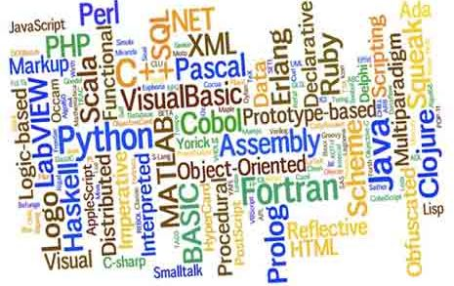
The Shape of Languages to Come

Slide 2
A (Brief) History of ME
Formed the company in 1982.
Previously teaching Engineering in Brighton.
Met the DEC PDP-11 and was hooked.
Over the years used between 20-30 different computer languages …..
….. but real passion is High Performance Computing (HPC).
Run a number of “meetup” groups.

Slide 3
Synopsis of the Talk
Taxonomy of programming languages.
What is this LLVM about anyway?
How quick is quick?
A demo using Julia
New Languages for Old
Q & A

Slide 4
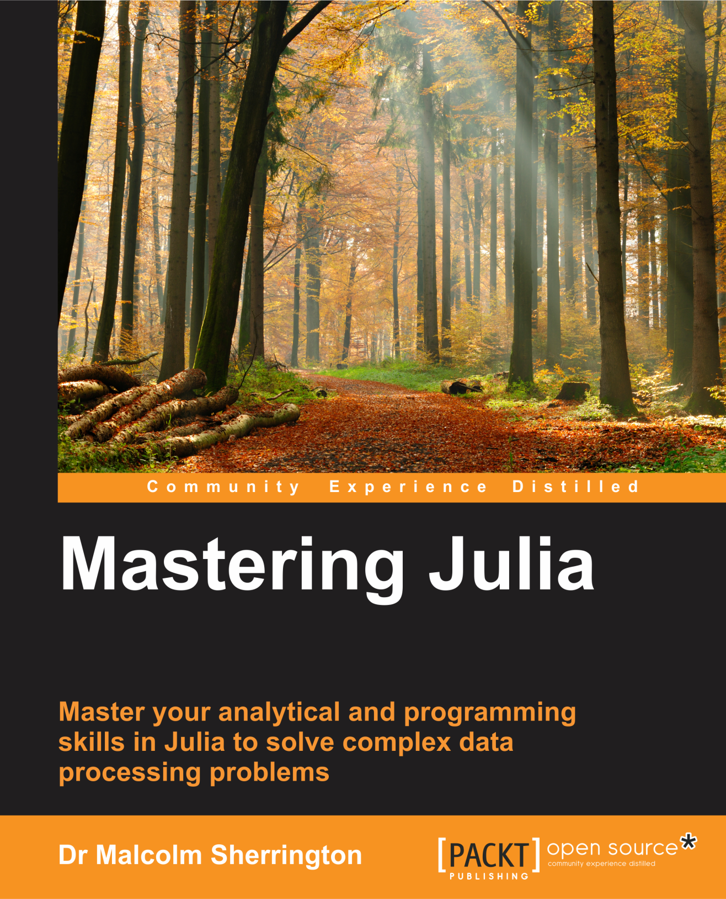

Slide 5
Taxonomy of programming languages
A programmer’s perspective
By application area
Systemic viewpoint

Slide 6
Systemic viewpoint
Assembly languages
Compilers
Interpreters
Intermediate code
LLVM (Jitterring)

Slide 7
Assembly Languages
Machine specific
1-to-1 correspondence between the computer architecture and the code
Typically two passes through the code
Used for on-board systems and operating system kernels
Still common with FPGA’s

Slide 8
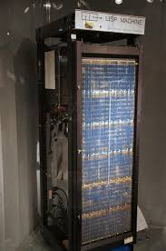
1950’s Languages
FORTRAN (1954)
LISP (1957)
ALGOL (1958)
COBOL (1959)
JOVIAL (1959)
The computer language paradox

Slide 9
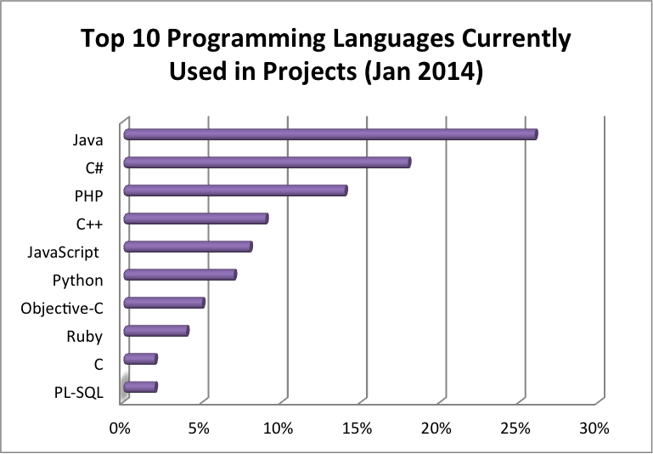

Slide 10
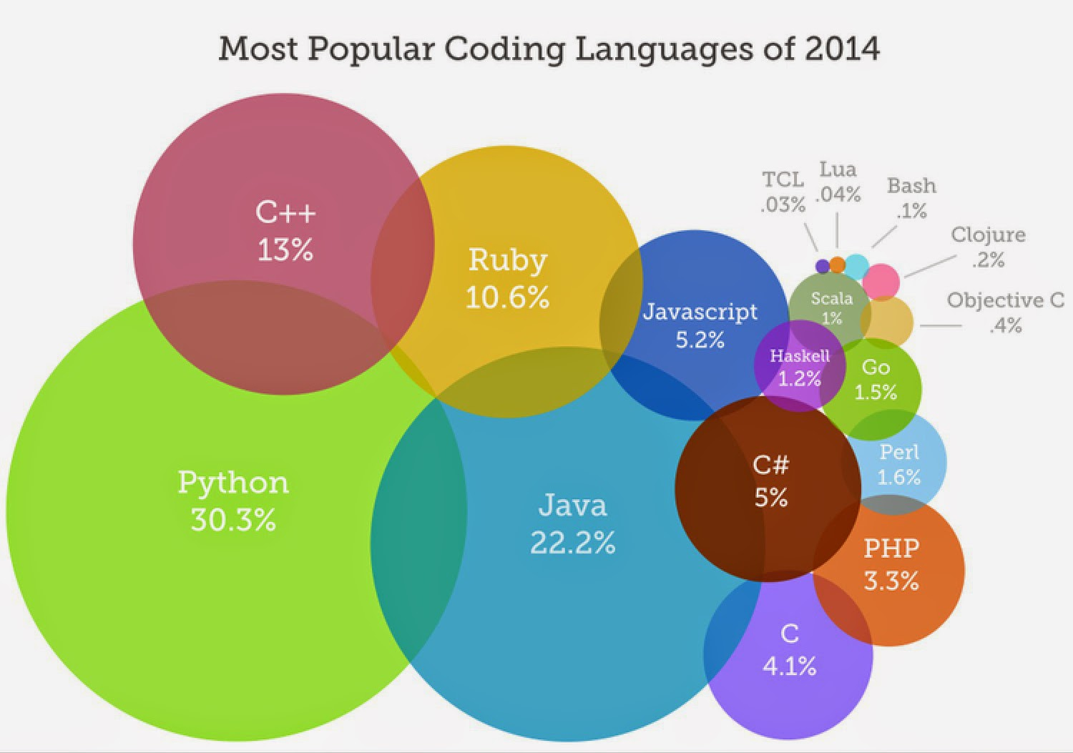

Slide 11

The LLVM project started at UIUC in 2003
Main architect was Chris Lattner, now with Apple
Is a JIT-tering system which converts IR code to specific assembly/machine code
Currently supports: X86, X86-64, ARM, AArch64, Mips, SystemZ, PowerPC
http://www.llvm.org

Slide 12
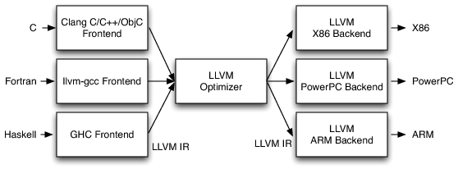
LLVM processing chain

Slide 13
What systems are now using LLVM?
As a compiler: Clang, Swift, GNU, Haskell, Ruby LDC, Clasp, LLgo
As a “bolt-on” module / extension Python (Numba), Tcl
As a complete system Julia, Javascript (V8), LuaJIT, Rust SML, Pure
http://llvm.org/devmtg/2016-01/slides/fosdem-2016-llvm.pdf

Slide 14
How Fast is Fast?
Regular derivative (stock option) pays out at the termination of the contract.
There is a formula based on the work of Black & Scholes in the 1970’s
A up or down turn at the end of the contract period can be disastrous
The Asian option uses an average price over the contract rather than the final one
This is computationally intense

Slide 15
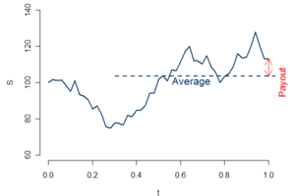
“Simple” Asian Option

Slide 16
S = zeros(Float64,N,T) A = zeros(Float64,N) for n=1:N S[n,1] = S0 dW = randn(T)*sqrt(dt) for t=2:T z0 = (r - q - 0.5*v*v)*S[n,t-1]*dt z1 = v*S[n,t-1]*dW[t] z2 = 0.5*v*v*S[n,t-1]*dW[t]*dW[t] S[n,t] = S[n,t-1] + z0 + z1 + z2 end A[n] = mean(S[n,:]) end
P = zeros(Float64,N) [ P[n] = max(A[n] - K, 0) for n = 1:N ] price = exp(-r*tma)*mean(P)

Slide 17
Asian Benchmarks
Results for 100,000 runs of 100 steps, (c ~ 0.73 s)
Language | Timing (c = 1) | Asian Option
c | 1.0 | 1.681
julia | 1.41 | 1.680
python (v3) | 32.67 | 1.671
R | 154.3 | 1.646
Octave | 789.3 | 1.632
Samsung RV711 laptop with an i5 processor and 4Gb RAM running Centos 6.5 (Final)

Slide 18


Slide 19


Slide 20

Once establised programming languages are long lived but the time at the top is short!
Advances in hardware and software may new approaches possible.
Emergence of new environments such as cloud computing.
Changes in application areas, such as big data and mobile apps.
Shift to analyst coding rather than specialist programmers.

Slide 21
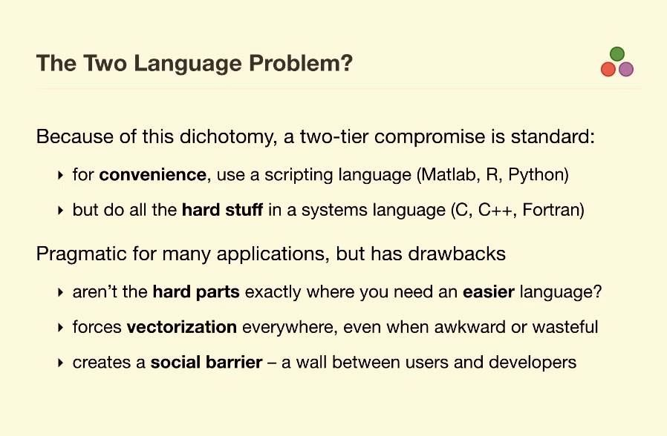

Slide 22

Quo Vadis LLVM? http://llvm.org
Dragonegg (code generation for GCC)
LLDB (native debugger)
Libc++ ABI (including C++11)
OpenMPI support
Vmkit (JVM and .NET)
Libclc (OpenCL)
Kee (intelligent bug finder)

Slide 23


Slide 24

The Genie is out of the bottle, things will not be the same again.
All (new) major languages in the last five years incorporate some form of JIT-tering.
LLVM project is the main O/S and has an exciting agenda planned.
Parallelism and HPC is becoming increasing important.
Never again will languages as slow as Matlab, R and (even) Python be created and certainly not paid for.

Slide 25


